Slide 1


Can BERT Understand How You Feel?
Sentiment Analysis & Text Classification using a Pre-trained BERT Model
Presented By: Vedanti Raut Saachi Laturiya Utkarsh Salunkhe Vaidik Samarth
Guided By:
Dr. Anuradha Yenkikar

Slide 2





The Words Aren’t Enough
Context changes the meaning
Sentiment Analysis : The task of identifying the emotional tone or sentiment expressed in text.
Same word – SICK
But entirely different meanings that is because sentiment depends on context
So how does the machine figure out what we actually mean?
BERT uses context

Slide 3








BERT : A Powerful Language Model That Understands Context.
PRE TRAINED BERT
Learns general language representation from large text copera.
FINE TUNING
Adapts BERT to our classification task using the SMILE dataset
7 CLASS CLASSIFIER
Predicts the emotion of the tweet
Model : bert-base-uncased

Slide 4
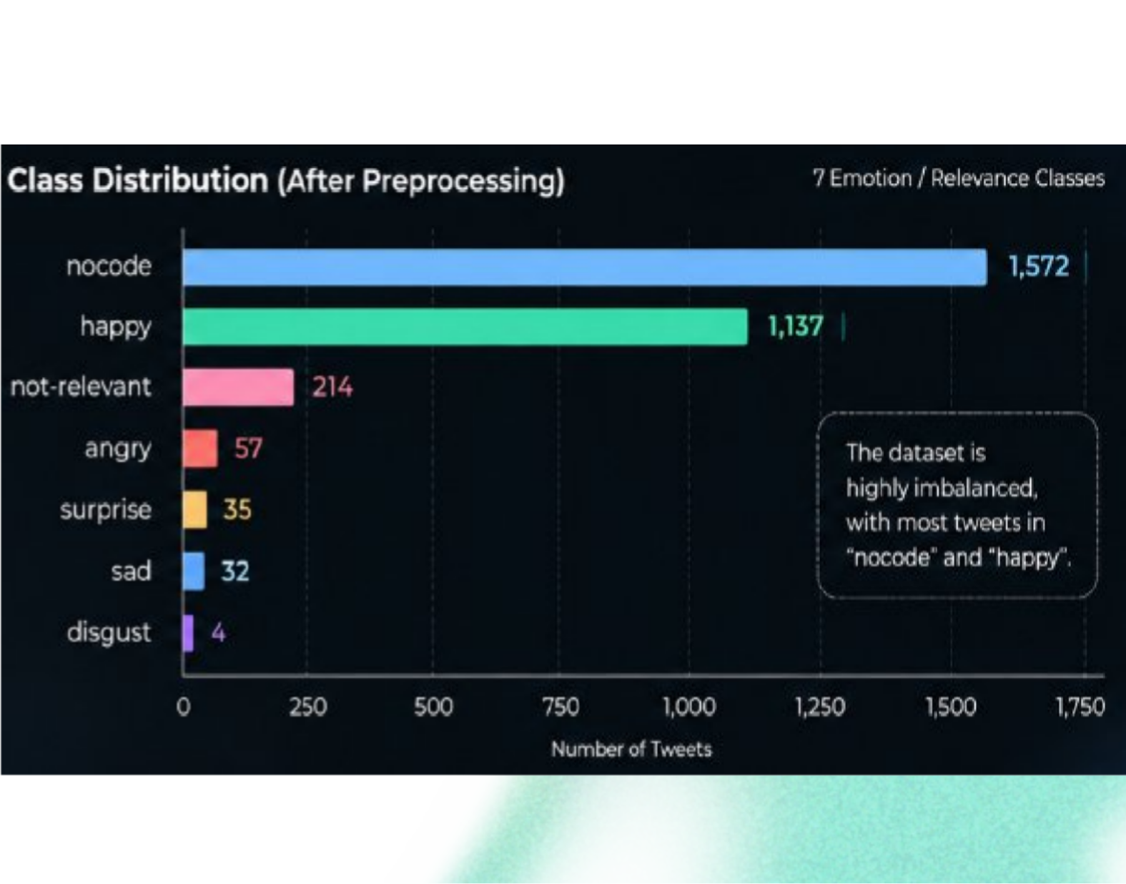
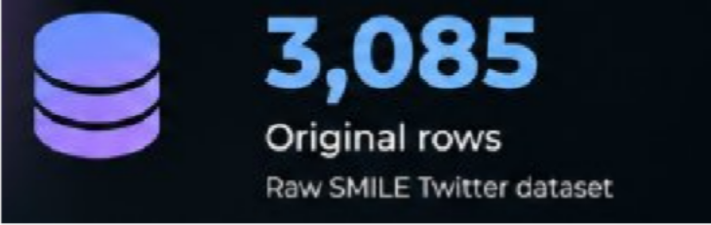

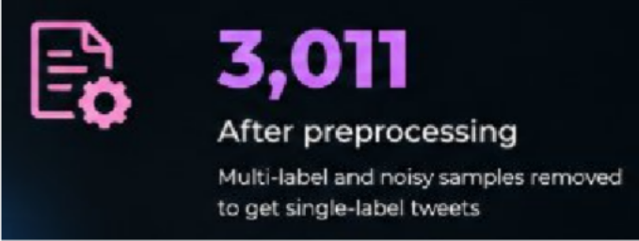
The Data
Real tweets that propose real complexity.
7
Different classes
This imbalance makes the classification task more challenging. Especially for the emotions that have the least data entries.

Slide 5
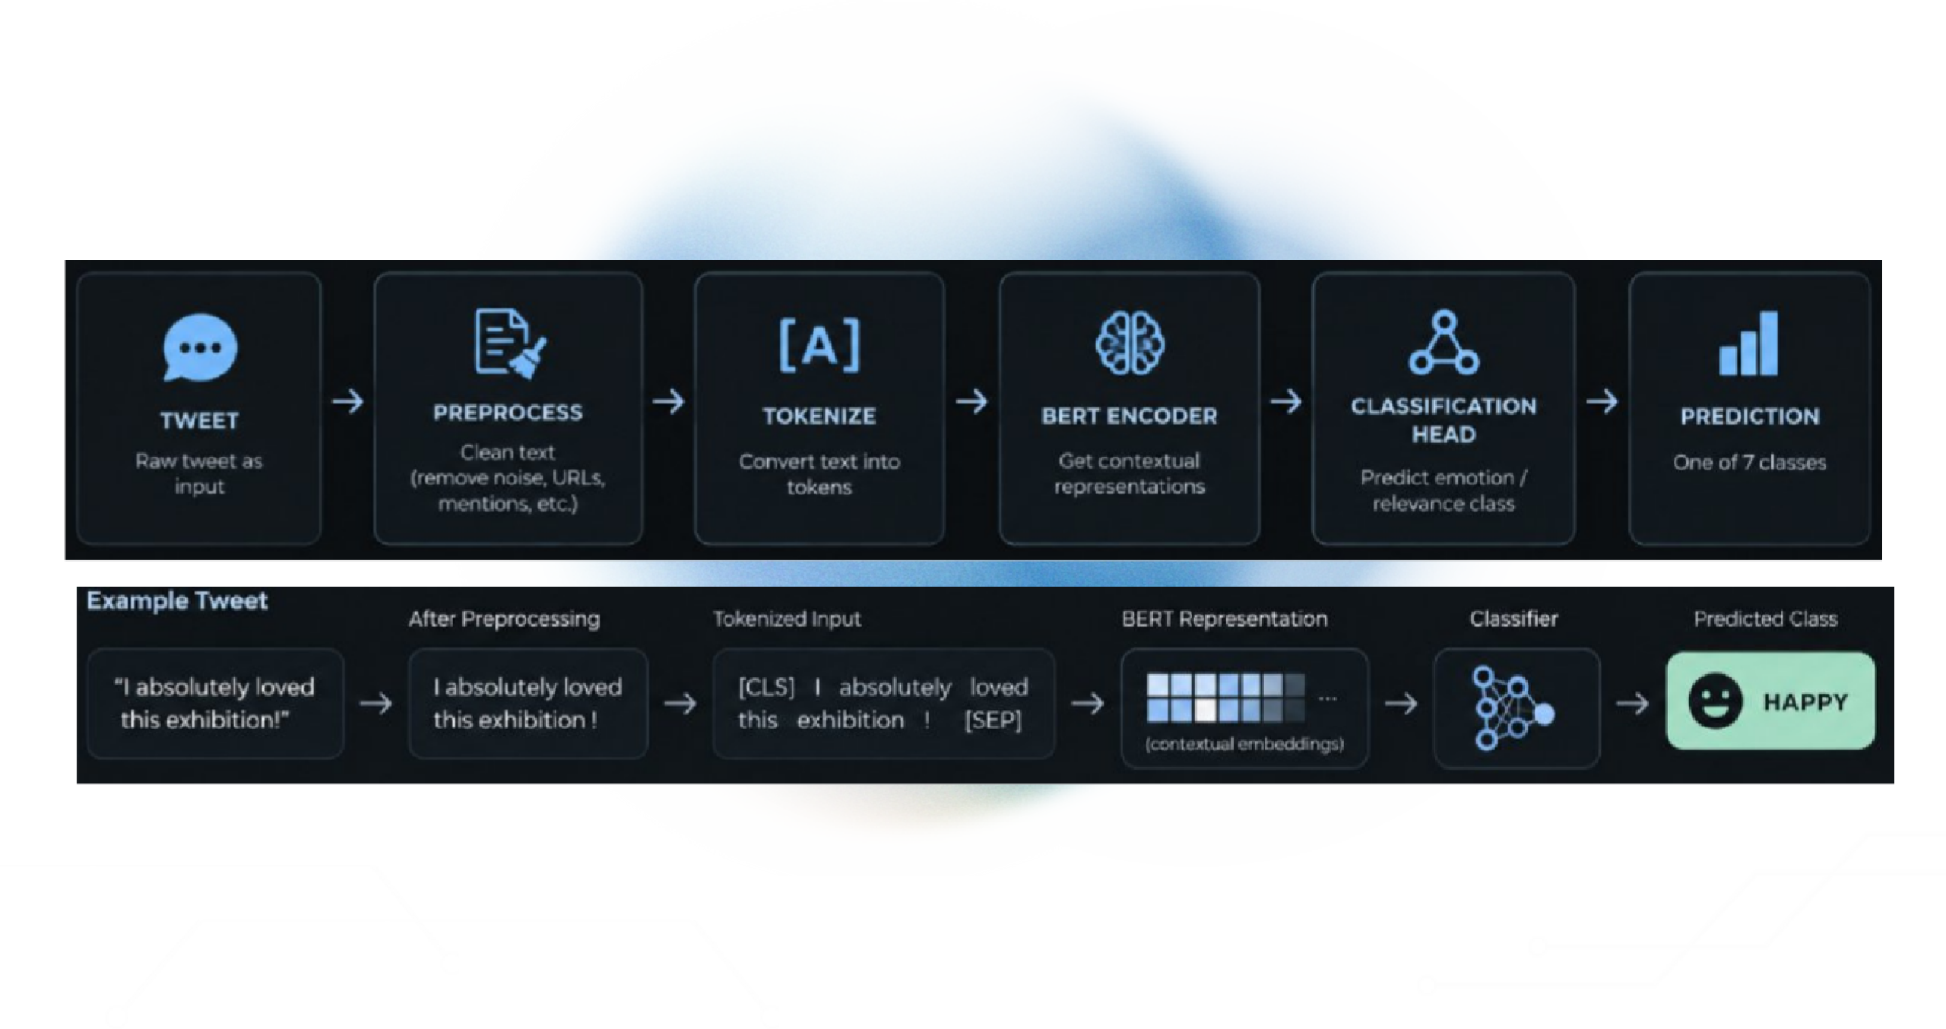
From Text To Prediction
How the BERT model actually works
A raw tweet goes into the model, a prediction comes out

Slide 6
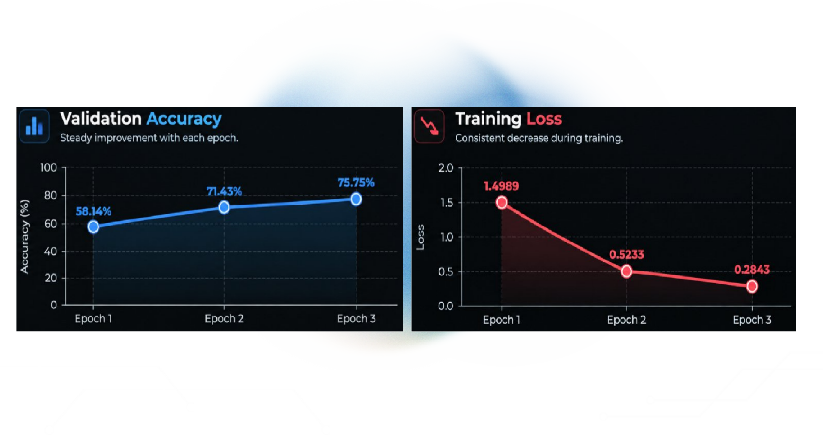
How The Model Learns
Validation accuracy rises while training loss falls across 3 epochs
Accuracy ↑
Loss ↓

Slide 7



The Results
How well did BERT perform on unseen data?
76.16 %
TEST ACCURACY
Overall correctness on unseen data
54.75 %
MACRO-F1
76.93 %
WEIGHTED-F1
Equal Weight to every class
Reveals performance on minority classes
Influenced by majority classes
Higher due to class imbalanace in the
dataset
Accuracy alone cannot be used to judge the model performance..
The F1 scores clearly addresses the underlying problem of an imbalanced dataset

Slide 8
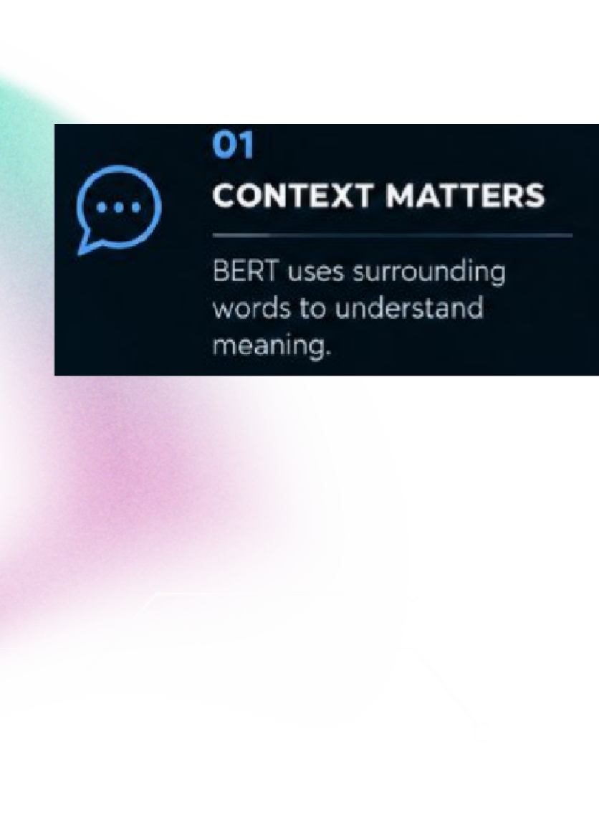
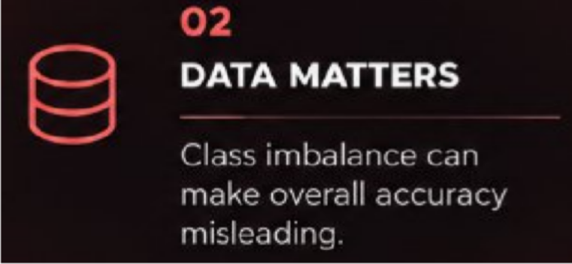
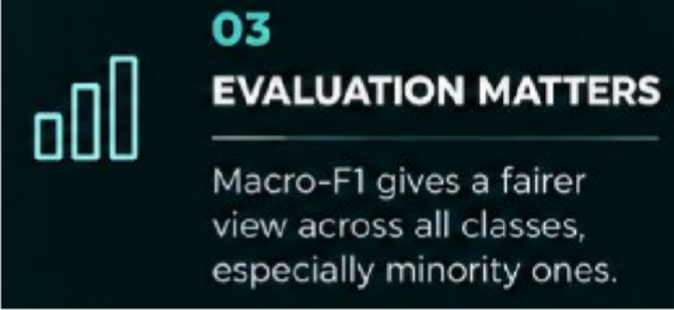
So.. Can BERT Actually Understand What You
Feel?
BERT doesn’t really feel emotions, it learns patterns and context in language to classify what the text expresses
Understanding sentiment isn't about reading emotions — it's about learning the patterns that express them

Slide 9

References & Materials
— BERT
Devlin, J., Chang, M.-W., Lee, K., & Toutanova, K.
BERT: Pre-training of Deep Bidirectional Transformers for Language Understanding.
— Sentiment Classification using BERT
GeeksforGeeks
Sentiment Classification Using BERT
— Dataset
SMILE Twitter Emotion Dataset
Used for emotion/sentiment classification.
— Implementation
Python · PyTorch · Hugging Face Transformers · Google Colab/Jupyter Notebook

Slide 10
Explore The Project
Code. Dataset. Notebook. Presentation.

